Slide 1
Chapter 2
The External Environment: Opportunities, Threats, Industry Competition and Competitor Analysis

Slide 2
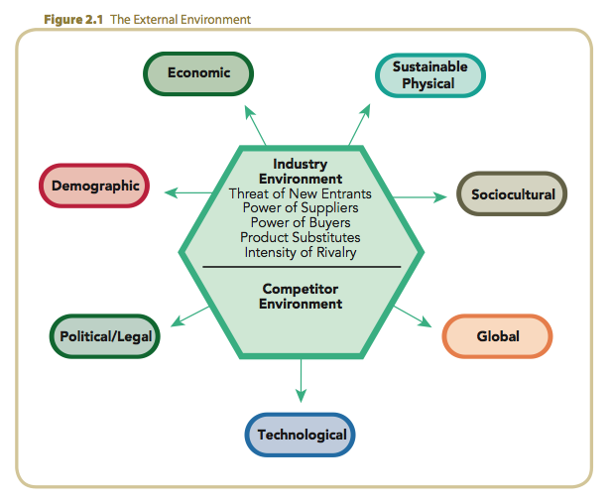
The External Environment

Slide 3
General Environment
Dimensions in the broader society that influence an industry and the firms within it:
  demographic
  economic
  political/legal
  sociocultural
  technological
  global
  physical

Slide 4
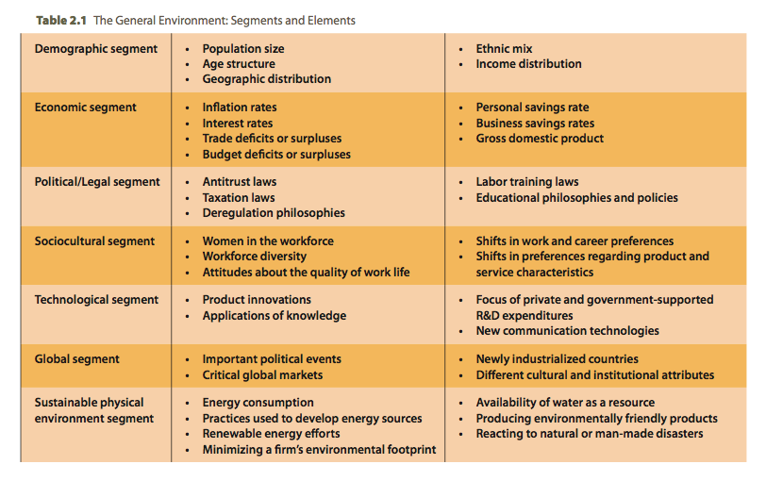
The General Environment: Segments and Elements

Slide 5
Industry Environment
The set of factors directly influencing a firm and its competitive actions and competitive responses:
  threat of new entrants
  power of suppliers
  power of buyers
  threat of product substitutes
  intensity of rivalry among competitors

Slide 6

Competitor Analysis
Gathering and interpreting information about all of the companies that the firm competes against.
Understanding the firm’s competitor environment complements the insights provided by studying the general and industry environments.

Slide 7
External Environmental Analysis
General Environment
  Focused on the future
Industry Environment
  Focused on factors and conditions influencing a firm’s profitability within an industry
Competitor Environment
  Focused on predicting the dynamics of competitors’ actions, responses and intentions

Slide 8
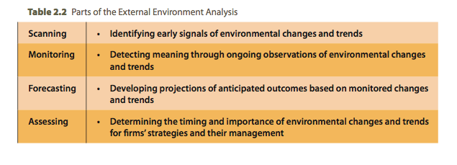
Components of the External Environmental Analysis

Slide 9

Opportunities and Threats
Opportunity
  A condition in the general
  environment that, if exploited
  effectively, helps a firm achieve
  strategic competitiveness.
Threat
  A condition in the general environment that may hinder a firm’s efforts to achieve strategic competitiveness.

Slide 10
Segments of the General Environment
Geographic
distribution
Age
structure
Ethnic mix
The demographic segment
Population
size
Income distribution

Slide 11

Segments of the General Environment (cont’d)
The Economic Segment
  Uncertainty in:
    market growth rates
    consumer demand
    inflation and interest rates
    trade deficits or surpluses
    budget deficits or surpluses
    personal and business savings rates
    gross domestic product

Slide 12

Segments of the General Environment (cont’d)
The Political/Legal Segment
  Regulations
  Consumer privacy laws
  Lobbying
  Antitrust, deregulation laws
  Taxation

Slide 13
Segments of the General Environment (cont’d)
The Sociocultural Segment
  Changing attitudes and cultural values
    Attitudes and approaches to health care
    Attitudes about quality of worklife
    Diverse and aging workforce
    Women in the workplace
    Concerns about environment
    Shifts in work and career preferences
    Shifts in product and service preferences

Slide 14
Segments of the General Environment (cont’d)
The Technological Segment
  Product innovations
  Rapid technological change and the risk of disruption
  Knowledge application
  Growth of the Internet
  New communication technologies

Slide 15
Segments of the General Environment (cont’d)
Important
geopolitical
trends
Critical
global niche
markets
Growth of
the informal economy
Different
cultural and institutional
attributes
Global focusing

Slide 16
Segments of the General Environment (cont’d)
The Physical Environment Segment
  Emerging trends oriented to sustaining the world’s physical environment
  Recognition of the interactive influence of ecological, social, and economic systems
  Growing concerns for sustainable industry development and increased corporate social responsibility for the future effects of globalized operations

Slide 17
Industry Environment Analysis
Industry Defined
  A group of firms producing products that are close substitutes
  Competitive strategies to pursue above-average returns when competing in a particular industry
  An industry’s structural characteristics influence a firm’s choice of strategies

Slide 18
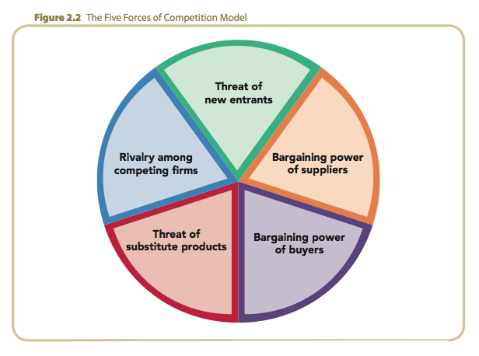
The Five Forces of Competition Model

Slide 19
Threat of New Entrants: Barriers to Entry
Economies of scale
Product differentiation
Capital requirements
Switching costs
Access to distribution channels
Cost disadvantages independent of scale
Government policy
Expected retaliation

Slide 20
Barriers to Entry
Economies of Scale
  Marginal improvements in efficiency that a firm experiences as it incrementally increases its size.
Factors (advantages and disadvantages) related to large and small-scale entry include:
  flexibility in pricing and market share
  costs related to scale economies
  competitor retaliation

Slide 21
Barriers to Entry (cont’d)
Product Differentiation
  Unique products
  Customer loyalty
  Products at competitive prices
Capital Requirements
  Physical facilities
  Inventories
  Marketing activities
  Availability of capital
Switching Costs
  One-time costs customers incur buying from a different supplier:
    new equipment
    retraining employees
    psychic costs of ending a relationship
Distribution Channel Access
  Stocking or shelf space
  Price breaks
  Cooperative advertising allowances

Slide 22
Barriers to Entry (cont’d)
Cost Disadvantages Independent of Scale
  Proprietary product technology
  Favorable access to
  raw materials
  Desirable locations
Government Policy
  Licensing and permit requirements
  Deregulation of industries
Expected Retaliation
  Responses by existing competitors may depend on a firm’s present stake in the industry (available business options)

Slide 23
Bargaining Power of Suppliers
Supplier power increases when:
  suppliers are large and few in number.
  suitable substitute products are not available.
  individual buyers are not large customers of suppliers and there are many of them.
  suppliers’ goods are critical to the buyers’ marketplace success.
  suppliers’ products create high switching costs.
  suppliers pose a threat to integrate forward into buyers’ industry.

Slide 24
Bargaining Power of Buyers
Buyer power increases when:
  buyers are large and few in number.
  buyers purchase a large portion of an industry’s total output.
  buyers’ purchases are a significant portion of a supplier’s annual revenues.
  buyers’ switching costs are low.
  buyers can pose threat to integrate backward into the sellers’ industry.

Slide 25
Threat of Substitute Products
The threat of substitute products increases when:
  buyers face few switching costs.
  the substitute product’s price is lower.
  substitute product’s quality and performance are equal to or greater than the existing product.
Differentiated industry products that are valued by customers reduce this threat

Slide 26
Intensity of Rivalry Among Competitors
Industry rivalry increases when:
  there are numerous or equally balanced competitors.
  industry growth slows or declines.
  there are high fixed costs or high storage costs.
  there is a lack of differentiation opportunities or low switching costs.
  when the strategic stakes are high.
  when high exit barriers prevent competitors from leaving the industry.

Slide 27
Interpreting Industry Analyses
Low entry barriers
Suppliers and buyers have strong positions
Unattractive
industry
Strong threats from substitute products
Intense rivalry among competitors
(Low profit potential)

Slide 28
Interpreting Industry Analyses (cont’d)
High entry barriers
Suppliers and buyers have weak positions
Attractive
industry
Few threats from substitute products
Moderate rivalry among competitors
(High profit potential)

Slide 29
Strategic Groups
Strategic Group Defined
  A set of firms emphasizing similar strategic dimensions and using similar strategies.
  Intra-strategic group competition is more intense than is inter-strategic group competition due to similar:
    market positions
    products
    strategic actions

Slide 30
Strategic Groups
Strategic Dimensions
  Extent of technological leadership
  Product quality
  Pricing policies
  Distribution channels
  Customer service
Implications
  Intense competitive rivalry within a group threatens profitability of all group members
  Strengths of the five forces differ across strategic groups
  The closer the groups are in their strategies, the greater the rivalry between groups

Slide 31
Competitor Analysis
Competitor Intelligence
  The ethical gathering of needed information
  and data that provides understanding of what:
    drives the competitor, as shown by its future objectives.
    the competitor is doing and can do, as revealed by its current strategy.
    the competitor believes about the industry, as shown by its assumptions.
    the competitor’s capabilities are, as shown by its strengths and weaknesses.

Slide 32
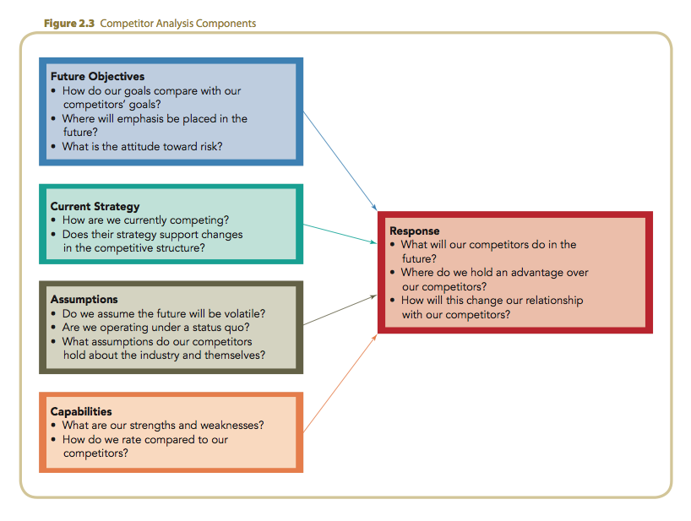
Competitor Analysis Components

Slide 33
Complementors
Complementors
  The network of companies that sell complementary products or services or are compatible with the focal firm’s own product or service.
    If a complementor’s product or service adds value to the sale of the focal firm’s product or service, it is likely to create value for the focal firm.
    However, if a complementor’s product or service is in a market into which the focal firm intends to expand, the complementor can represent a formidable competitor.

